Slide 1
Module 2 Final Project
The King County Project

Slide 2
The Deliverables
Jupyter Notebook
README.md file
PowerPoint Presentation
Video Walkthrough

Slide 3

Problem Statement
As a Real Estate Agent, I have been tasked with investigating house sales in the King County area and building a model to predict sale prices based on historical data.

Slide 4

Business Value
Give recommendations to potential clients on how to make the best decision when purchasing or selling their home.

Slide 5
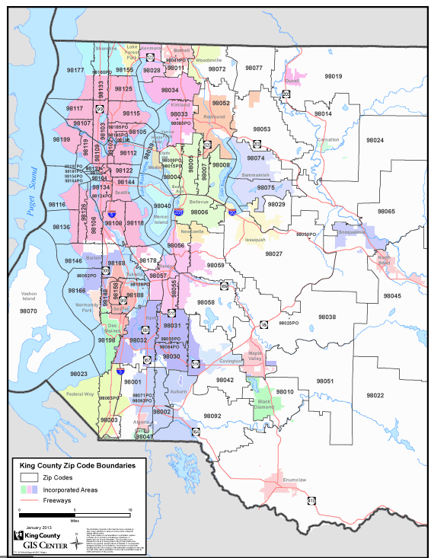
The Datasets
kc_house_data.csv
King County Glossary

Slide 6
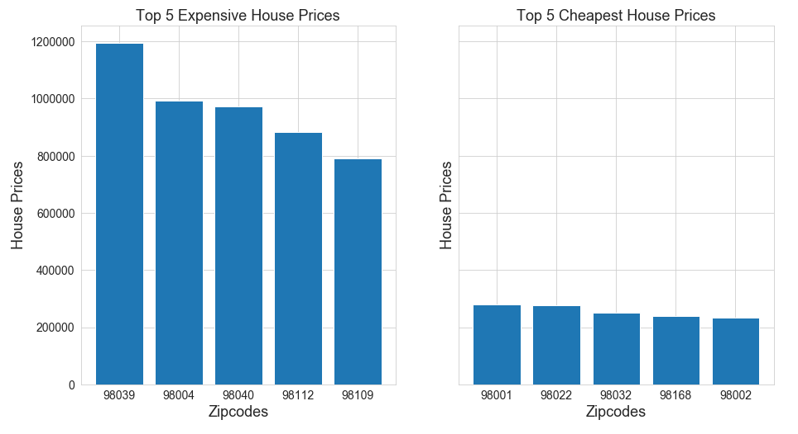
Top 5 Most Expensive Homes in King County
Top 5 Least Expensive Homes in King County

Slide 7
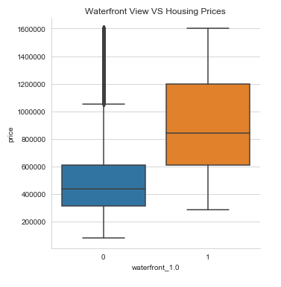
Does Having a Waterfront Make a Difference? YES

Slide 8
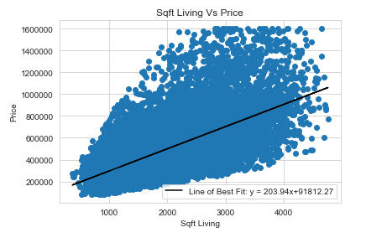
Does Having More Square Footage make a Difference? YES

Slide 9
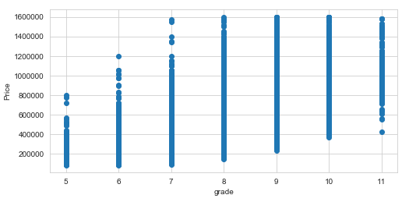
Do Different Grades Make a Difference? YES
9 - Better architectural design with extra interior and exterior design and quality.
10 - Homes of this quality generally have high quality features. Finish work is better and more design quality is seen in the floor plans. Generally have a larger square footage. 11 - Custom design and higher quality finish work with added amenities of solid woods, bathroom fixtures and more luxurious options.
5 - Low construction costs and workmanship. Small, simple design. 6 - Lowest grade currently meeting building code. Low quality materials and simple designs. 7 - Average grade of construction and design. Commonly seen in plats and older sub-divisions. 8 - Just above average in construction and design. Usually better materials in both the exterior and interior finish work.

Slide 10

Recommendations:
Different Grade, Size of the House, Zip-Code and Having a Waterfront View Or Not makes a difference when purchasing or selling your next home.
Contact The Abbasi Bros Realty & Let Me Help You Make The Best Decision…

Slide 11

Future Work
Research the Job Market in King County
What Do Homes Lease For?
Is King County a Profitable County to Invest On?

Slide 12

Any Questions?

